Slide 1

CHAPTER 7
PROPERTIES OF FUNCTIONS
Copyright © Cengage Learning. All rights reserved.

Slide 2

7.1
Functions Defined on General Sets
Copyright © Cengage Learning. All rights reserved.

Slide 3
Functions Defined on General Sets
As used in ordinary language, the word function indicates dependence of one varying quantity on another. If your teacher tells you that your grade in a course will be a function of your performance on the exams, you interpret this to mean that the teacher has some rule for translating exam scores into grades.
To each collection of exam scores there corresponds a certain grade.

Slide 4
Functions Defined on General Sets
In this chapter we focus on the more dynamic way functions are used in mathematics. The following is a restatement of the definition of function that includes additional terminology associated with the concept.

Slide 5
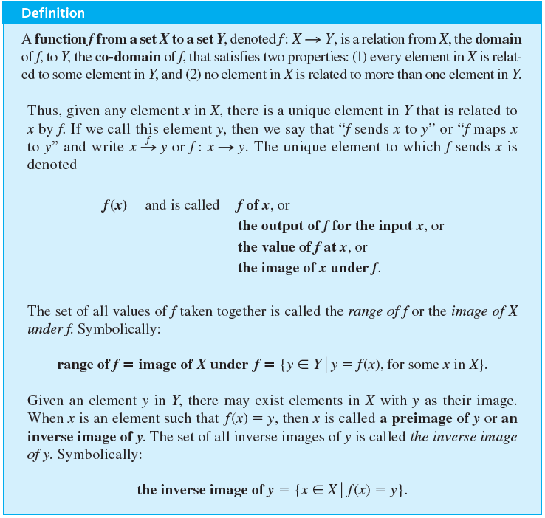
Functions Defined on General Sets

Slide 6
Functions Defined on General Sets
The concept of function was developed over a period of centuries. A definition similar to that given above was first formulated for sets of numbers by the German mathematician Lejeune Dirichlet (DEER-ish-lay) in 1837.

Slide 7
Arrow Diagrams

Slide 8
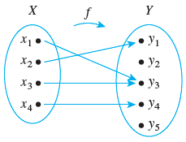
Arrow Diagrams
If X and Y are finite sets, you can define a function f from X to Y by drawing an arrow diagram. You make a list of elements in X and a list of elements in Y, and draw an arrow from each element in X to the corresponding element in Y, as shown in Figure 7.1.1.
Figure 7.1.1

Slide 9
Arrow Diagrams
This arrow diagram does define a function because:
1. Every element of X has an arrow that points to an element in Y.
2. No element of X has two arrows that point to two different
elements of Y.

Slide 10
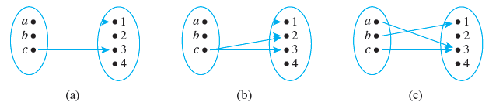
Example 7.1.1 – Functions and Nonfunctions
Which of the arrow diagrams in Figure 7.1.2 define functions from X = {a, b, c} to Y = {1, 2, 3, 4}?
Figure 7.1.2

Slide 11
Example 7.1.1 – Solution
Only (c) defines a function.
In (a) the element b in X is not related to any element of Y because there is no arrow that points from b to an element in Y.
And in (b) the element c is not related to a unique element of Y because from c there are two arrows that point to two different elements of Y—one toward 2 and the other toward 3.

Slide 12
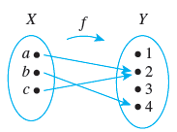
Example 7.1.2 – A Function Defined by an Arrow Diagram
Let X = {a, b, c} and Y = {1, 2, 3, 4}. Define a function f from X to Y by the arrow diagram in Figure 7.1.3.
Figure 7.1.3

Slide 13
Example 7.1.2 – A Function Defined by an Arrow Diagram
continued
a. Write the domain and co-domain of f.
b. Find f (a), f (b), and f (c).
c. What is the range of f?
d. Is c an inverse image of 2? Is b an inverse image of 3?
e. Find the inverse images of 2, 4, and 1.
f. Represent f as a set of ordered pairs.

Slide 14
Example 7.1.2 – Solution
a. domain of f = {a, b, c}, co-domain of f = {1, 2, 3, 4}
b. f(a) = 2, f(b) = 4, f(c) = 2
c. range of f = {2, 4}
d. yes, no

Slide 15
Example 7.1.2 – Solution
continued
e. inverse image of 2 = {a, c}
inverse image of 4 = {b}
inverse image of 1 =
(since no arrows point to 1)
f. {(a, 2), (b, 4), (c, 2)}

Slide 16
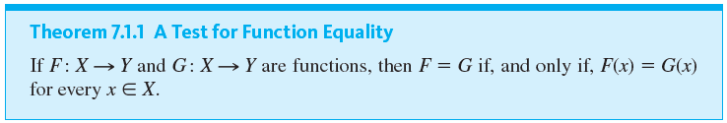
Arrow Diagrams

Slide 17
Example 7.1.3 – Equality of Functions
a. Let J₃ = {0, 1, 2}, and define functions f and g from J₃ to J₃ as follows:
For every x in J₃,
Does f = g?

Slide 18
Example 7.1.3 – Equality of Functions
continued
b. Let F : R → R and G : R → R be functions. Define new functions F + G : R → R and G + F : R → R as follows: For every x ∈ R,
(F + G)(x) = F(x) + G(x) and (G + F)(x) = G(x) + F(x).
Does F + G = G + F?

Slide 19
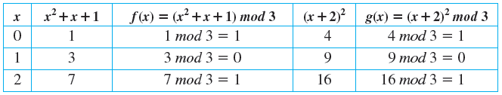
Example 7.1.3 – Solution
a. Yes, the table of values shows that f (x) = g(x) for every x in J₃.

Slide 20
Example 7.1.3 – Solution
continued
b. Again the answer is yes. For every real number x,
(F + G)(x) = F(x) + G(x)
by definition of F + G
= G(x) + F(x)
by the commutative law for addition of real numbers
= (G + F)(x)
by definition of G + F.
Hence F + G = G + F.

Slide 21
Examples of Functions

Slide 22
Examples of Functions
The next examples illustrate some of the wide variety of different types of functions.

Slide 23

Example 7.1.4 – The Identity Function on a Set
Given a set X, define a function I_{X} from X to X by
I_{X} (x) = x for each x in X.
The function I_{X} is called the identity function on X because it sends each element of X to the element that is identical to it. Thus the identity function can be pictured as a machine that sends each piece of input directly to the output chute without changing it in any way.
are elements of
X. Find
Let X be any set, and suppose that
and

Slide 24
Example 7.1.4 – Solution
Whatever is input to the identity function comes out unchanged, so

Slide 25




Example 7.1.5 – Sequences
The formal definition of sequences specifies that an infinite sequence is a function defined on the set of integers that are greater than or equal to a particular integer. For example, the sequence denoted
can be thought of as the function f from the nonnegative integers to the real numbers that associates
and, in general,

Slide 26

Example 7.1.5 – Sequences
continued
In other words,
is the function defined as follows:
Send each integer
In fact, there are many functions that can be used to define a given sequence. For instance, express the sequence above as a function from the set of positive integers to the set of real numbers.

Slide 27



Example 7.1.5 – Solution
Define
for each
Then
and, in general,

Slide 28
Example 7.1.6 – A Function Defined on a Power Set
We know that
denotes the set of all subsets of the set A. Define a function
as follows: For each
F(X) = the number of elements in X.
Draw an arrow diagram for F.

Slide 29
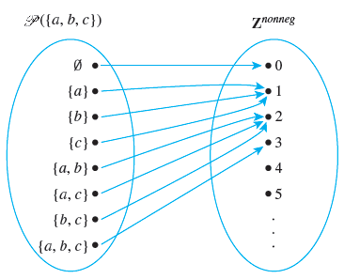
Example 7.1.6 – Solution

Slide 30
Example 7.1.7 – Functions Defined on a Cartesian Product
Define functions
as follows: For each ordered pair (a, b) of integers,
M(a, b) = ab and R(a, b) = (−a, b).
Then M is the multiplication function that sends each pair of real numbers to the product of the two, and R is the reflection function that sends each point in the plane that corresponds to a pair of real numbers to the mirror image of the point across the vertical axis.

Slide 31

Example 7.1.7 – Functions Defined on a Cartesian Product
continued
Note It is customary to omit one set of parentheses for functions defined on Cartesian products. For example, we write M(a, b) rather than M((a, b)).
Find the following:
a. M(−1, −1) b.
c.
d. R(2, 5) e. R(−2, 5) f. R(3, −4)

Slide 32

Example 7.1.7 – Solution
a. (−1)(−1) = 1 b. (1 ∕ 2)(1 ∕ 2) = 1 ∕ 4
c.
d. (−2, 5)
e. (−(−2), 5) = (2, 5) f. (−3, −4)

Slide 33
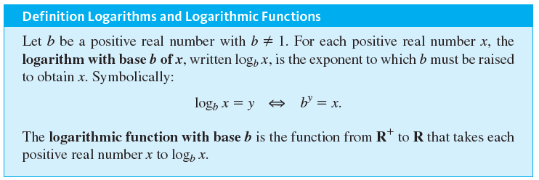
Examples of Functions

Slide 34


Example 7.1.8 – The Logarithmic Function with Base b
Find the following:
a. log₃ 9 b.
c. log₁₀ (1)
d.
(m is any real number)
e.

Slide 35



Example 7.1.8 – Solution
a. log₃ 9 = 2 because
b.
c. log₁₀ (1) = 0 because
d.
= m because the exponent to which 2 must be raised to obtain
is m.
e.
= m because log₂ (m) is the exponent to which 2 must be raised to obtain m.

Slide 36
Examples of Functions
If S is a nonempty, finite set of characters, then a string over S can be regarded as a finite sequence of elements of S. The number of characters in a string is called the length of the string.
The null string over S is the “string” with no characters. It is usually denoted λ and is said to have length 0.

Slide 37
Example 7.1.9 – Encoding and Decoding Functions
Digital messages consist of finite sequences of 0’s and 1’s. When they are communicated across a transmission channel, they are frequently coded in special ways to reduce the possibility that they will be garbled by interfering noise in the transmission lines.
For example, suppose a message consists of a sequence of 0’s and 1’s.

Slide 38
Example 7.1.9 – Encoding and Decoding Functions
continued
A simple way to encode the message is to write each bit three times. Thus the message
00101111
would be encoded as
000000111000111111111111.

Slide 39
Example 7.1.9 – Encoding and Decoding Functions
continued
The receiver of the message decodes it by replacing each section of three identical bits by the one bit to which all three are equal.
Let A be the set of all strings of 0’s and 1’s, and let T be the set of all strings of 0’s and 1’s that consist of consecutive triples of identical bits. The encoding and decoding processes described above are actually functions from A to T and from T to A.

Slide 40
Example 7.1.9 – Encoding and Decoding Functions
continued
The encoding function E is the function from A to T defined as follows: For each string s ∈ A,
E(s) = the string obtained from s by replacing each
bit of s by the same bit written three times.
The decoding function D is defined as follows: For each string t ∈ T,
D(t) = the string obtained from t by replacing each consecutive triple of three identical bits of t by a single copy of that bit.

Slide 41
Example 7.1.9 – Encoding and Decoding Functions
continued
The advantage of this particular coding scheme is that it makes it possible to do a certain amount of error correction when interference in the transmission channels has introduced errors into the stream of bits.
If the receiver of the coded message observes that one of the sections of three consecutive bits that should be identical does not consist of identical bits, then one bit differs from the other two.

Slide 42
Example 7.1.9 – Encoding and Decoding Functions
continued
In this case, if errors are rare, it is likely that the single bit that is different is the one in error, and this bit is changed to agree with the other two before applying the decoding function.

Slide 43
Example 7.1.10 – The Hamming Distance Function
The Hamming distance function, named after the computer scientist Richard W. Hamming, is very important in coding theory. It gives a measure of the “difference” between two strings of 0’s and 1’s that have the same length. Let S_{n} be the set of all strings of 0’s and 1’s of length n.
Define a function
as follows: For each pair of strings (s, t) ∈ S_{n} × S_{n},
H(s, t) = the number of positions in which s and t have different values.

Slide 44
Example 7.1.10 – The Hamming Distance Function
continued
Thus, letting n = 5,
H(11111, 00000) = 5
because 11111 and 00000 differ in all five positions, whereas
H(11000, 00000) = 2
because 11000 and 00000 differ only in the first two positions.

Slide 45
Example 7.1.10 – The Hamming Distance Function
continued
a. Find H(00101, 01110).
b. Find H(10001, 01111).

Slide 46
Example 7.1.10 – Solution
a. 3
b. 4

Slide 47
Boolean Functions

Slide 48
Boolean Functions
Any input/output table defines a function in the following way: The elements in the input column can be regarded as ordered tuples of 0’s and 1’s; the set of all such ordered tuples is the domain of the function.
The elements in the output column are all either 0 or 1; thus {0, 1} is taken to be the co-domain of the function. The relation sends each input element to the output element in the same row.

Slide 49
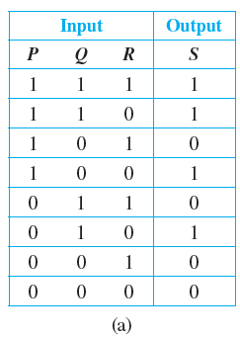
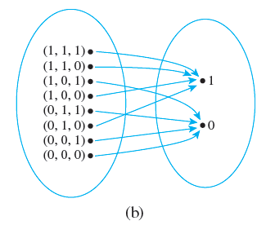
Boolean Functions
Thus, for instance, the input/output table of Figure 7.1.4(a) defines the function with the arrow diagram shown in Figure 7.1.4(b).
Two Representations of a Boolean Function
Figure 7.1.4

Slide 50
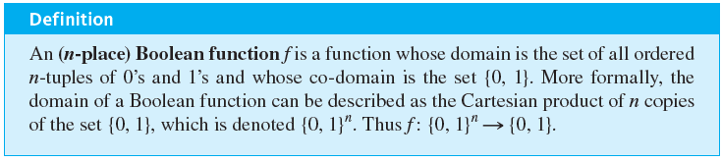
Boolean Functions
More generally, the input/output table corresponding to a circuit with n input wires has n input columns. Such a table defines a function from the set of all n-tuples of 0’s and 1’s to the set {0, 1}.

Slide 51
Example 7.1.11 – A Boolean Function
Consider the three-place Boolean function defined from the set of all 3-tuples of 0’s and 1’s to {0, 1} as follows: For each triple (x₁, x₂, x₃) of 0’s and 1’s,
f (x₁, x₂, x₃) = (x₁ + x₂ + x₃) mod 2.
Describe f using an input/output table.

Slide 52
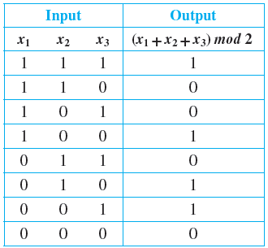
Example 7.1.11 – Solution
f (1, 1, 1) = (1 + 1 + 1) mod 2 = 3 mod 2 = 1
f (1, 1, 0) = (1 + 1 + 0) mod 2 = 2 mod 2 = 0
The rest of the values of f can
be calculated similarly to obtain
the following table.

Slide 53
Checking Whether a Function Is Well Defined

Slide 54
Checking Whether a Function Is Well Defined
It can sometimes happen that what appears to be a function defined by a rule is not really a function at all. To give an example, suppose we wrote, “Define a function f : R → R by specifying that for each real number x,
f (x) is the real number y such that
There are two distinct reasons why this description does not define a function. For almost all values of x, either (1) there is no y that satisfies the given equation or (2) there are two different values of y that satisfy the equation.

Slide 55
Checking Whether a Function Is Well Defined
For instance, when x = 2, there is no real number y such that
and when x = 0, both y = −1 and y = 1 satisfy the equation
In general, we say that a “function” is not well defined if it fails to satisfy at least one of the requirements for being a function.

Slide 56

Example 7.1.12 – A Function That Is Not Well Defined
We know that Q represents the set of all rational numbers. Suppose you read that a function f : Q → Z is to be defined by the formula
for all integers m and n with n ≠ 0.
is m. Is f well defined? Why?
That is, the integer associated by f to the number

Slide 57



Example 7.1.12 – Solution
The function f is not well defined. The reason is that fractions have more than one representation as quotients of integers.
For instance,
Now if f were a function, then the definition of a function would imply that
since

Slide 58


Example 7.1.12 – Solution
continued
But applying the formula for f, you find that
and so
This contradiction shows that f is not well defined and, therefore, is not a function.

Slide 59
Functions Acting on Sets

Slide 60
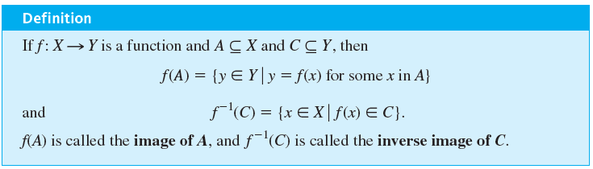
Functions Acting on Sets
Given a function from a set X to a set Y, you can consider the set of images in Y of all the elements in a subset of X and the set of inverse images in X of all the elements in a subset of Y.

Slide 61
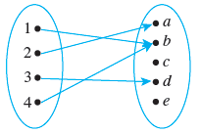

Example 7.1.13 – The Action of a Function on Subsets of a Set
Let X = {1, 2, 3, 4} and Y = {a, b, c, d, e}, and define
F : X →Y by the following arrow diagram:
Let A = {1, 4}, C = {a, b}, and D = {c, e}. Find F(A), F(X),
and

Slide 62
Example 7.1.13 – Solution
F(A) = {b}
F(X) = {a, b, d}

Slide 63
Example 7.1.14 – Interaction of a Function with Union
Let X and Y be sets, let F be a function from X to Y, and let A and B be any subsets of X.
Prove that F(A ∪ B) ⊆ F(A) ∪ F(B).

Slide 64
Example 7.1.14 – Solution
The fact that X, Y, F, A, and B were formally introduced prior to the word “Prove” allows you to regard their existence and relationships as part of your background knowledge.
Thus to prove that F(A ∪ B) ⊆ F(A) ∪ F(B), you only need show that if y is any element in F(A ∪ B), then y is an element of F(A) ∪ F(B).

Slide 65
Example 7.1.14 – Solution
Proof:
Suppose y ∈ F(A ∪ B). [We must show that y ∈ F(A) ∪ F(B).] By definition of function, y = F(x) for some x ∈ A ∪ B. By definition of union, x ∈ A or x ∈ B.
Case 1, x ∈ A: In this case, y = F(x) for some x in A. Hence
y ∈ F(A), and so by definition of union, y ∈ F(A) ∪ F(B).

Slide 66
Example 7.1.14 – Solution
Case 2, x ∈ B: In this case, y = F(x) for some x in B. Hence y ∈ F(B), and so by definition of union, y ∈ F(A) ∪ F(B).
Thus in either case y ∈ F(A) ∪ F(B) [as was to be shown].

